Slide 1
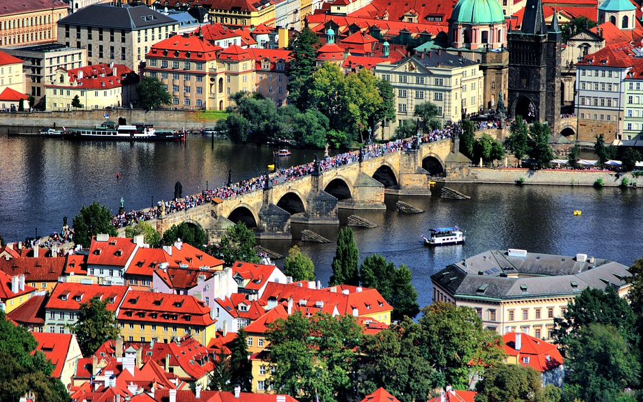
Czech Republic Cultural tourism
Cultural tourism experiences include:
Architectural and Archaeological Treasures
Culinary Activities
Festivals or Events
Historic or Heritage sites
Monuments and Landmarks
Museums and Exhibitions
Tourism of Czech Republic

Slide 2
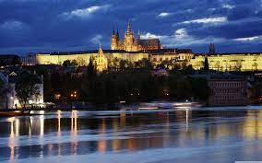
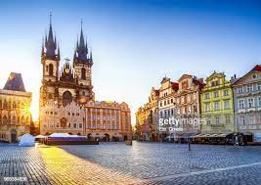
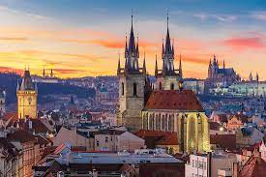
Europe’s World City
Czech Republic
The Czech Republic, also known by its short-form name Czechia is a landlocked country in Central Europe. It is bordered by Austria to the south, Germany to the west, Poland to the northeast, and Slovakia to the southeast. The Czech Republic has a hilly landscape that covers an area of 78,871 square kilometers (30,452 sq. mi) with a mostly temperate continental and oceanic climate. The capital and largest city is Prague, and other major cities include Brno and Ostrava.

Slide 3
Geographical Location
The Czech Republic is a land-locked country in Central Europe. It is bordered by Germany to the west, Austria to the south, Slovakia to the east and Poland to the north. It consists mostly of low hills and plateaus surrounded along the borders by low mountains. Two areas of lowlands follow the Elbe river and the Morava river. About a third of the area of the Czech Republic is covered by forests.
The Czech Republic also possesses Moldauhafen, a 30,000 enclave in the middle of Hamburg docks in Germany, which was awarded to Czechoslovakia by Article 363 of the Treaty of Versailles to allow the landlocked country a place where goods transported down river could be transferred to seagoing ships. This territory reverts to Germany in 2028.

Slide 4
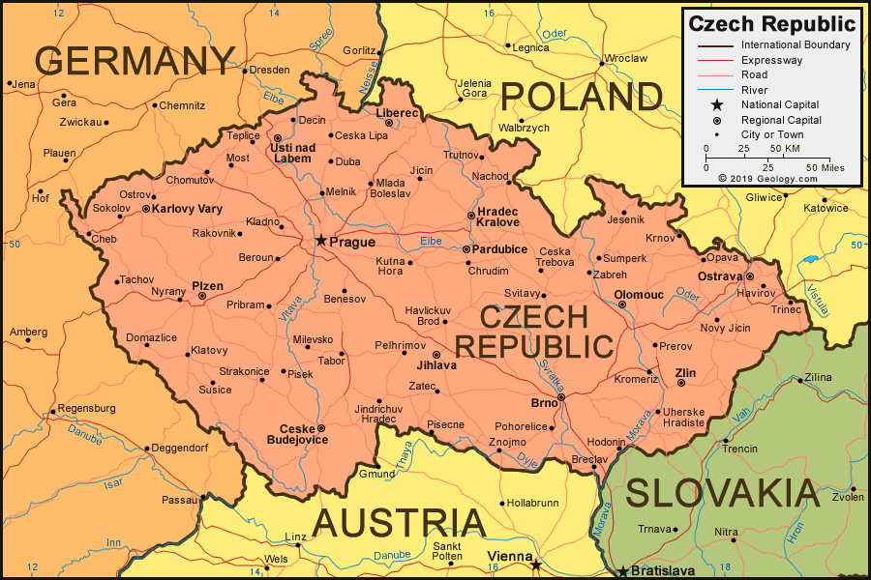
Geographical Location

Slide 5
Law of Czech Republic
Czech law, often referred to as the legal order of the Czech Republic (právní řád České republiky), is the system of legal rules in force in the Czech Republic, and in the international community it is a member of. Czech legal system belongs to the Germanic branch of continental legal culture (civil law).
Climate
The Czech Republic's climate is temperate, transitional between an oceanic climate and a continental climate. The summers are rather cool and dry, with average temperatures in most areas around 20 °C, the winters are fairly mild and wet with temperatures averaging around 0 °C in most areas. The relative humidity moves between 60 and 80 %.

Slide 6
Flag of Czech Republic
The national flag of the Czech Republic (Czech: státní vlajka České republiky) or flag of Czechia (vlajka Česka), or Czech Flag (česká vlajka) is the same as the flag of the former Czechoslovakia. Upon the dissolution of Czechoslovakia in 1993, the Czech Republic kept the Czechoslovak flag while Slovakia adopted its own flag. The first flag of Czechoslovakia was based on the flag of Bohemia and was white over red. This was almost identical to the flag of Poland (only the proportion was different), so a blue triangle was added at the hoist in 1920. The flag was banned by the Nazis in 1939 as they established a government nominally in control of Bohemia and Moravia, and a horizontal tricolor of white, red, and blue was used for the duration of the war. The 1920 flag was restored in 1945.

Slide 7
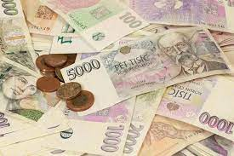
Currency of Czech Republic
The Czech koruna, also known as Czech Crown, (sign: Kč; code: CZK, Czech: koruna česká) has been the currency of the Czech Republic since 1993. The koruna is one of the European Union's 11 currencies, and the Czech Republic is legally bound to adopt the euro currency in the future.
The official name in Czech is koruna česká (plural koruny české, though the zero-grade genitive plural form korun českých is used on banknotes and coins of value 5 Kč or higher). The ISO 4217 code is CZK and the local acronym is Kč, which is placed after the numeric value (e.g., "50 Kč") or sometimes before it (as is seen on the 10-koruna coin). One koruna equals 100 haléřů (abbreviated as "h", singular: haléř, nominative plural: haléře, genitive plural: haléřů – used with numbers higher or equal to 5 – e.g. 3 haléře, 8 haléřů), but haléře have been withdrawn, and the smallest unit of physical currency is 1 Kč. Despite its withdrawal haléře are still present in prices of various products, but are rounded to koruna at checkout.

Slide 8
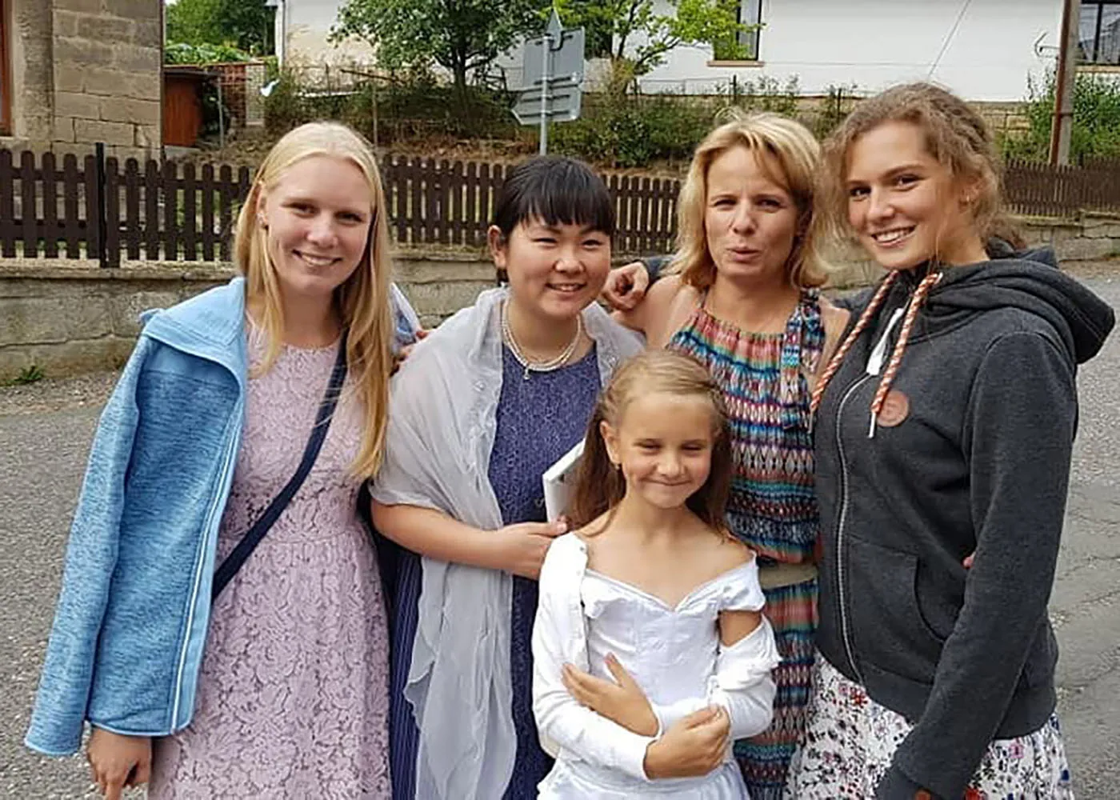
Culture of Czech Republic
In Czech Republic culture, families are warm, friendly, and welcoming. They rarely have more than two children and it's common for extended family members to live together, especially grandparents. In small towns, people live in apartment blocks but enjoy visiting their country cottages during the weekend.

Slide 9
Popular festivals in the Czech Republic
Christmas. Christmas is celebrated almost all over the world but in this country, it is done with true fervor. ...
Barborky or Feast of Saint Barbara
Velikonoce or Easter
Burning of Witches
Lovers' Day
Royal Silvering.
Feast of the Rose of the Five Petals
Prague Spring.

Slide 10
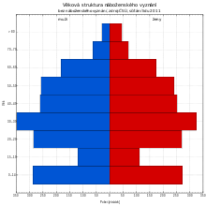
Religion in the Czech Republic
Religion in the Czech Republic is varied, with a vast majority of the population (78%) being either irreligious (atheist, agnostic or other irreligious life stances) or declaring neither religious nor irreligious identities, and almost equal minorities represented by Christianity (11.7%, almost entirely Catholicism) and other religious identities or beliefs (10.8%).

Slide 11
Entertainment Tourism
Prague Castle
Prague Charles Bridge
St. Vitus Cathedral

